Slide 1
73rd Constitutional Amendment Act
&
Its Impact on Rural Development
Ms. Khushbu Prasad
Assistant Professor, Amity University Patna

Slide 2

What is Panchayati Raj System ?
Panchayati Raj is a system of local self government followed in India.
The aim of Panchayati Raj system is to percolate the democracy to grass root level in Indian society.
It is meant to ensure that local administrative affairs, particularly in rural areas, should be resolved by local government units constituted with elected members.
The modern Panchayati Raj system in India consists of three levels :
1. Gram Panchayat at Village level,
2. Panchayat Samiti at Block level,
3. Zilla Parishad at District level.
73rd Constitution Amendment Act (1992) to Indian Constitution confer the right to local self government to villages.

Slide 3
Evolution of Panchayati Raj System.
The Panchayat system in India is NOT purely a modern phenomenon.
In fact, village panchayat existed in India for centuries.
In ancient India, panchayats were usually elected councils with executive and judicial powers.
The evolution of the Panchayati Raj System got a fillip after the attainment of independence and after the drafting of the Constitution.
The Constitution of India in Article 40 enjoined: “The state shall take steps to organize village panchayats and endow them with such powers and authority as may be necessary to enable them to function as units of self-government”.
There were a number of committees appointed by the Government of India to study the implementation of self-government at the rural level and also recommend steps in achieving this goal.
The committees appointed are as follows:
1. Balwant Rai Mehta Committee (1957)
2. Ashok Mehta Committee (1977)
3. G V K Rao Committee (1985)
4. L M Singhvi Committee (1986)

Slide 4
Significance of 73rd Constitution Amendment Act, 1992
The Act is a very significant step in creating democratic institutions at the grassroots level in the country. The Act has transformed the representative democracy into participatory democracy.
The Act added Part IX to the Constitution, “The Panchayats” and also added the Eleventh Schedule which consists of the 29 functional items of the panchayats.
Part IX of the Constitution contains Article 243 to Article 243 O.
This 73rd Amendment Act provides shape to Article 40 of the Constitution which is directive principles of state policy, which directs the state to organize the village panchayats and provide them powers and authority so that they can function as self-government.

Slide 5
Salient Features of 73rd Constitution Amendment Act, 1992
Organization of Gram Sabhas. Gram Sabha is the primary body of the Panchayati Raj system. It is a village assembly consisting of all the registered voters within the area of the panchayat. It will exercise powers and perform such functions as determined by the state legislature.
Creation of a three-tier Panchayati Raj Structure at the District (Zila), Block and Village levels;
Almost all posts, at all levels to be filled by direct elections;
Minimum age for contesting elections to the Panchayati Raj institutions be twenty one (21) years;
The post of Chairman at the District and Block levels should be filled by indirect election;
There should be reservation of seats for Scheduled Castes/ Scheduled Tribes in Panchayats, in proportion to their population, and for women in Panchayats up to one-third seats;
State Election Commission to be set up in each State to conduct elections to Panchayati Raj institutions;
The tenure of Panchayati Raj institutions is five years, if dissolved earlier, fresh elections to be held within six months; and
A State Finance Commission is to be set up in each State every five years.

Slide 6
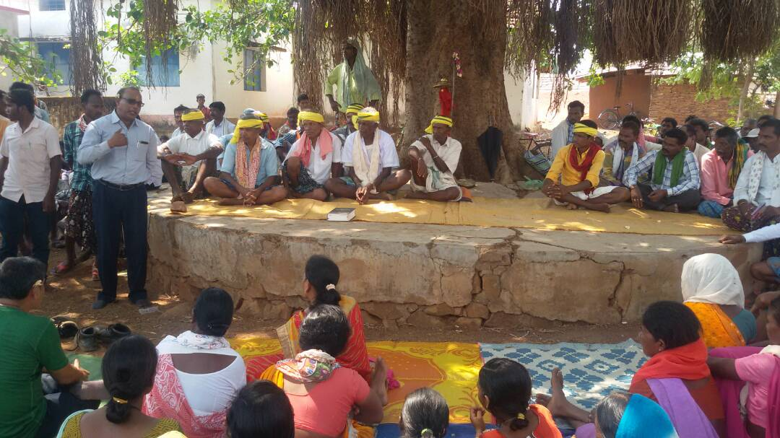
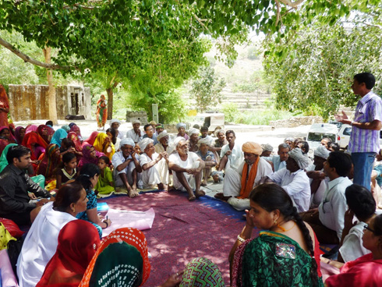
These are the some images of Gram Sabha i.e. Assembly of villagers

Slide 7
Functions of Gram Panchayat
Gram Panchayat is primary level of Panchayati Raj system.
The civic functions relating to sanitation, cleaning of public roads, minor irrigation, public toilets and lavatories, primary health care, vaccination, the supply of drinking water, constructing public wells, rural electrification, social health and primary and adult education, etc. are obligatory functions of village panchayats.
The optional functions depend on the resources of the panchayats. They may or may not perform such functions as tree plantation on roadsides, setting up of breeding centers for cattle, organizing child and maternity welfare, promotion of agriculture, etc.
After the 73rd Amendment, the scope of functions of Gram Panchayat was widened. Such important functions like preparation of annual development plan of panchayat area, annual budget, relief in natural calamities, removal of encroachment on public lands and implementation and monitoring of poverty alleviation programmes are now expected to be performed by panchayats.
Selection of beneficiaries through Gram Sabhas, public distribution system, non-conventional energy source, improved Chullahs, biogas plants have also been given to Gram Panchayats in some states.

Slide 8
Functions of Panchayat Samiti
Panchayat Samiti is intermediate level of Panchayati Raj system.
Panchayat Samitis are at the hub of developmental activities.
They are headed by Block Development Officers (B.D.Os).
Some functions are entrusted to them like agriculture, land improvement, watershed development, social and farm forestry, technical and vocational education, etc.
The second type of functions relates to the implementation of some specific plans, schemes or programmes to which funds are earmarked. It means that a Panchayat Samiti has to spend money only on that specific project. The choice of location or beneficiaries is, however, available to the Panchayat Samiti.

Slide 9
Functions of Zilla Parishad
Zilla Parishad is final level of Panchayati Raj system.
Zila Parishad links Panchayat Samitis within the district.
It coordinates their activities and supervises their functioning.
It prepares district plans and integrates Samiti plans into district plans for submission to the State Government.
Zila Parishad looks after development works in the entire district.
It undertakes schemes to improve agricultural production, exploit ground water resources, extend rural electrification and distribution and initiate employment generating activities, construct roads and other public works.
It also performs welfare functions like relief during natural calamities and scarcity, the establishment of orphanages and poor homes, night shelters, the welfare of women and children, etc.
In addition, Zila Parishads perform functions entrusted to them under the Central and State Government sponsored programmes. For example, Jawahar Rozgar Yojna is a big centrally sponsored scheme for which money is directly given to the districts to undertake employment-generating activities.

Slide 10
73rd Constitutional Amendment Act 1992 added 11th Schedule to the Constitution of India which list 29 subjects under the authority of Panchayat
Agriculture
Land reform, improvement, soil conservation.
Irrigation (minor, water management)
Animal husbandry, dairy and poultry
Social and farm forestry
Small scale industries
Rural housing, drinking water, electrification, roads, education etc.
Technical Training and Vocational education
Adult and non formal education
Cultural activities
Health and Sanitization etc.
Family welfare, women and child development
Social welfare, handicapped and mentally challenge people
Public distribution system
Maintenance of community assets

Slide 11
Rural Development
Rural development is the process of improving the quality of life and economic well-being of people living in rural areas.
There are total 6.64 lac villages in India.
According to 2011 Census 68.84% of population in India lives in villages. Thus the backwardness of the rural sector would be a major impediment to the overall progress of the economy.
Poverty is one of the most pertinent problem in rural India. Almost 90% of total population living under Below Poverty line lives in rural India.
This is the reason, rural India need urgent intervention in order to bring overall, holistic development in India.
In order to bring, social, economical and physical development in India, the local administration need to be made strong.
The Panchayati Raj system aims at improving the quality of life of people residing in rural India and bringing the democracy at their door step.

Slide 12
Role of Panchayati Raj system in Rural Development
To recognize development sector : All these levels of Panchayati Raj play very important role in recognizing the local development sectors within the limits of Panchayat. It also manage the way these development sectors are being utilize and make it financially viable.
Better implementation of Government Policies : The policies, programs, schemes announced by central and state governments are implemented by Panchayats at Zila, Tehsil as well as village level. Such as Swachh Bharat Mission, PM Aawas Yojana, Nutrition Programs through Aanganwadis etc.
Management of local resources : Panchayats play vital role in local natural resources management. It also formulate policies, rules and guidelines to manage the tourist places within the limits of Panchayats.
Cultural and religious Importance : Panchayats play very important role in preserving the local culture. The management of religious places, the organization of fairs, melas during the festival seasons and providing employment opportunities to locals are done by the Panchayats.
Social Justice : Rural Development is not just economic development but also social development. The role of Panchayati Raj system in Rural Development can be seen through following ways of Social Justice –
1. Role of Panchayati Raj in Economic Development
2. Role of Panchayati Raj in Women Empowerment

Slide 13
Role of Panchayati Raj system in Economic Development of Rural India
Maximized production and employment opportunities through agriculture, animal husbandry, pisciculture, and by adoption of best technologies and practices.
Value added products from agriculture, animal husbandry, pisciculture, non-timber forest produce.
Assured employment opportunities for all households in the village.
Ensuring the income of labourers to a level on par with other jobs and vocations in the country.
Ensuring equitable wages for men and women, zero child labour.
Employment opportunities for persons with disabilities.

Slide 14
Role of Panchayati Raj system in Women Empowerment
Dr. B.R.Ambedkar used to say that “I measure the progress of a community with the degree of progress women have achieved.”
Women’s empowerment is vital towards the development of the society.
‘Empowerment’ means ‘to authorize’.
A real women empowerment is not possible without ensuring their equitable participation in decision making process.
The 73rd Constitution Amendment Act 1992 ensure the equal political opportunities to women at Panchayat level.
It provides one-third reservation for women in Panchayati Raj system at two levels:
(i) for the office of the members and
(ii) for that of the chairperson.
With the advent of this Act, there are also 6,81,258 women elected to Gram Panchayats, 37,109 women to Panchayat at the intermediate level and 3153 women elected at the district level.

Slide 15
Through the experience of the Indian Panchayat Raj Institutions, more than one million women have actively entered into the political life of India. Reservation for women in panchayats (chairman and members) up to one-third seats.
Women’s issues have come to the forefront at the local level and consequently state and national level.
Women can work on the creation, development and promotion of Self Help groups, Cooperatives, MSMEs for better employment and livelihood options in Rural areas.
Women leaders in the Panchayati Raj are transforming local governance by sensitizing the State to issues of poverty, inequality and gender injustice.
Through Panchayati Raj, women are changing governance are evident in the issues they choose to tackle water scarsity, alcohol abuse, education, health and domestic violence.
Women are also taking action against child marriage and child domestic labor, promoting girl-child education. Also, women have used their elected authority to address quality health care as critical issues.

Slide 16
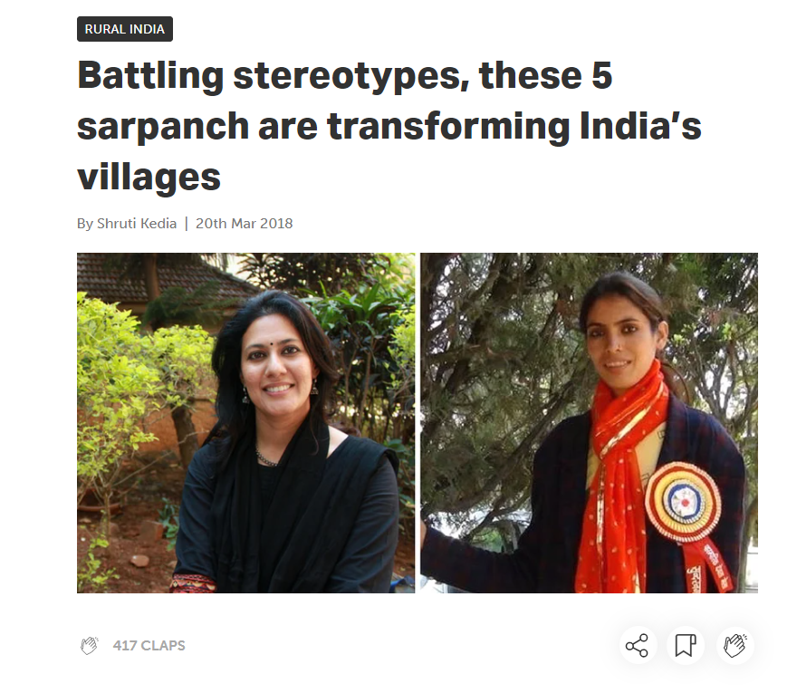
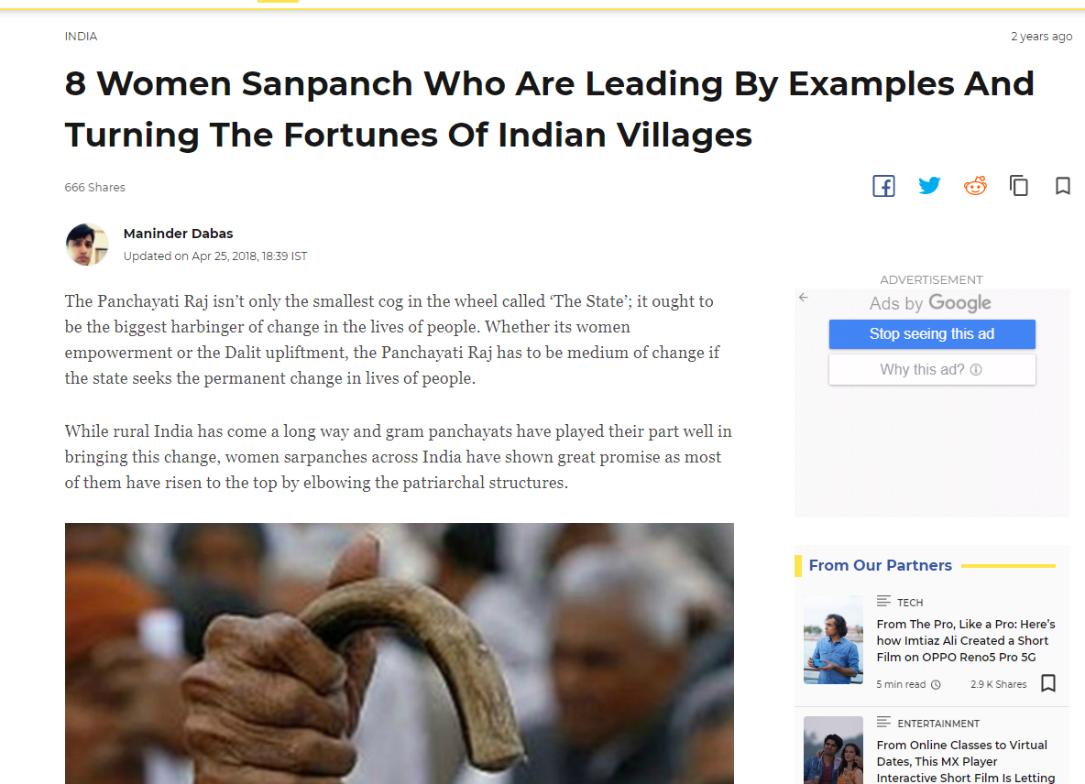
These are some stories of how some women leaders at grass root level are bringing change in the rural society.

Slide 17
Role of Gram Panchayat in Rural Development
There are total 2.5 lakh Gram Panchayats in the country.
They provide basic services in the villages and plan for local economic development.
Gram Sabha is smallest unit of Panchayati Raj system which consist of all people living in that Gram Panchayat.
Gram Panchayat implement programs, policies, schemes at village level.
It identifies the beneficiaries for central and state government schemes.
It also manage the natural resources such as water, forest etc. within the limits of Gram panchayat.
Gram Panchayat manages the Primary health centers, schools at Gram Panchayat level.
The decision making process of the panchayats is such that the Gram Sabha discusses the development work plans of the Gram Panchayat Development Plan (GPDP) and the elected representatives execute the plans. Formulation of GPDP improves efficiency of public services.
Since all eligible voters of the village can participate in the Gram Sabha, it is a channel to include the less privileged section of society and ensure their participation in the village level governance wherein they can advocate their developmental aspirations.

Slide 18
Problem with Panchayati Raj system
Unscientific distribution of functions : The functions of three levels of panchayats viz- Gram Panchayat, Panchayat Samiti and Zilla Panchayat are often clashes.
Incompatible relation between the three-tiers : For smooth functioning of Panchayati Raj system, all three tiers should work amicably. But most of the time, it shows conflict within the three tiers over powers, finances and authority.
Inadequate finances
Politicization of Panchayati Raj institutions due to elections
Lack of literacy among rural population.
Corruption at local level of administration.

Slide 19
Some recommendations for improving Panchayati Raj system
Devolution of powers : States should confer more powers to Panchayats.
Funding of panchayats: The financial dependence of Panchayats on State government should be minimize. More avenues of finances such as taxes, fees, fines should be given to Panchayats.
Capacity building: The social, economic as well physical infrastructure of Panchayats should be improved. The current capacities of Panchayats is inadequate due to rise in population and work load.
Digitalizing the Panchayats: The digitalization of Panchayats through computerization of system and connecting the Gram Panchayats through high speed internet must be done.
Awareness : Awareness among general public over their rights and the working of Panchayats.
Minimizing the corruption by providing more and more digital online services.
Minimizing the political interference in Panchayats through collective elections.

Slide 20
Thank You
Contact Details
Dr. G. N. Nimbarte
Department of Humanities and Social Sciences
Mobile – 9373045542
Email- gnimbarte@hum.vnit.ac.in

